Slide 1
Force vectors
Engineering mechanics

Slide 2
Outline
Scalars and Vectors
Vector Operations
Vector Addition of Forces
Cartesian Vectors
Addition of Cartesian Vectors
Coplanar Concurrent Forces
Non-coplanar Concurrent Forces

Slide 3
scalars
All physical quantities in engg: mechanics are measured using either scalars or vectors
Scalar:
A scalar is any positive or negative physical quantity that can be completely specified by its magnitude.
Eg: Length, Mass, and Time.

Slide 4
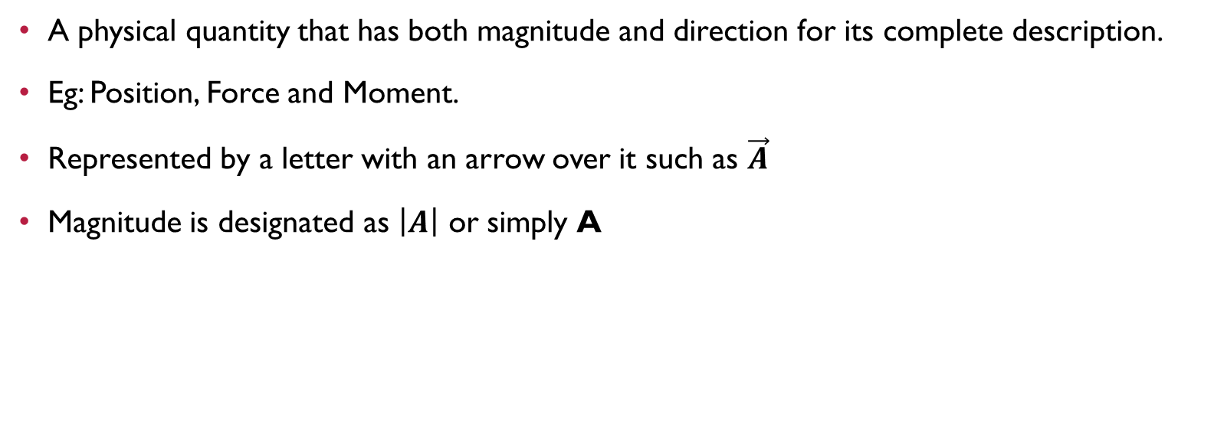
Vectors
A physical quantity that has both magnitude and direction for its complete description.
Eg: Position, Force and Moment.
Represented by a letter with an arrow over it such as $\vec{A}$
Magnitude is designated as $\left|A\right|$ or simply A

Slide 5
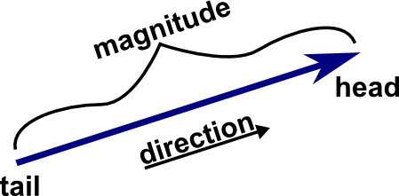
vectors
Represented graphically as an arrow
Length of arrow = Magnitude of vector
Angle between the reference axis and arrow’s line of action = Direction of vector
Arrowhead= Sense of vector

Slide 6
Vector Addition
Different Methods:
Parallelogram law
Triangle law
Polygon law
Cartesian method

Slide 7
Cartesian vectors
The operations of vector algebra, when applied to solving problems in three dimensions, are simplified if the vectors are first represented in Cartesian Vector form.

Slide 8
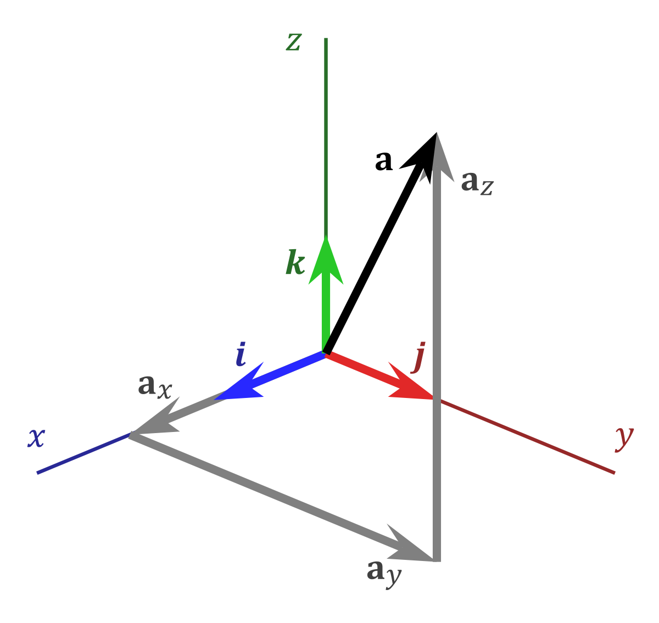
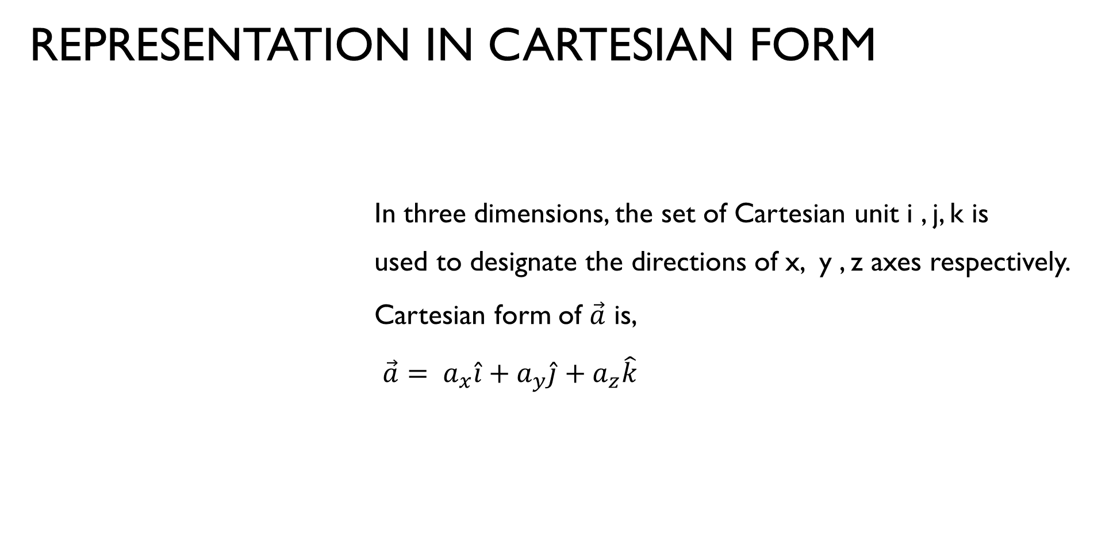
REPRESENTATION IN CARTESIAN FORM
In three dimensions, the set of Cartesian unit i , j, k is used to designate the directions of x, y , z axes respectively.
Cartesian form of $\vec{a}$ is,
$\vec{a}= a_{x}\hat{i}+a_{y}\hat{j}+a_{z}\hat{k}$

Slide 9

Magnitude of cartesian vector
It is always possible to obtain the magnitude of a provided it is expressed in cartesian form.
$\left|a\right|=\sqrt{{a_{x}}^{2}+{a_{y}}^{2}+{a_{z}}^{2}}$

Slide 10
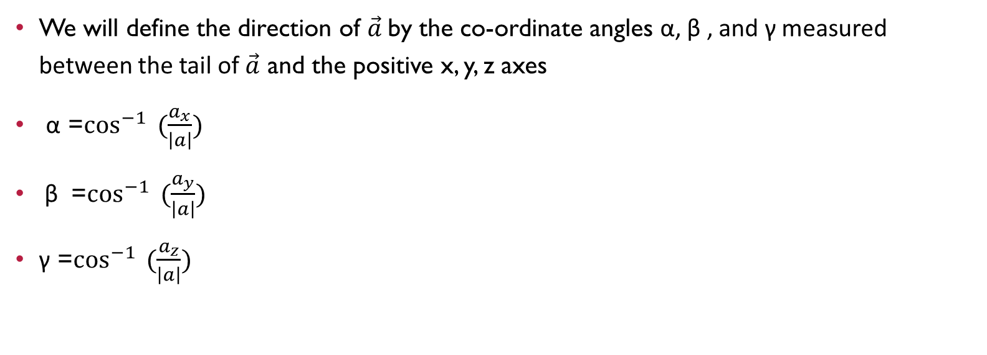
DIRECTION OF CARTESIAN VECTOR
We will define the direction of $\vec{a}$by the co-ordinate angles α, β , and γ measured between the tail of $\vec{a}$ and the positive x, y, z axes
α =$\cos^{−1}{ (\frac{a_{x}}{\left|a\right|})}$
β =$\cos^{−1}{ (\frac{a_{y}}{\left|a\right|})}$
γ =$\cos^{−1}{ (\frac{a_{z}}{\left|a\right|})}$

Slide 11
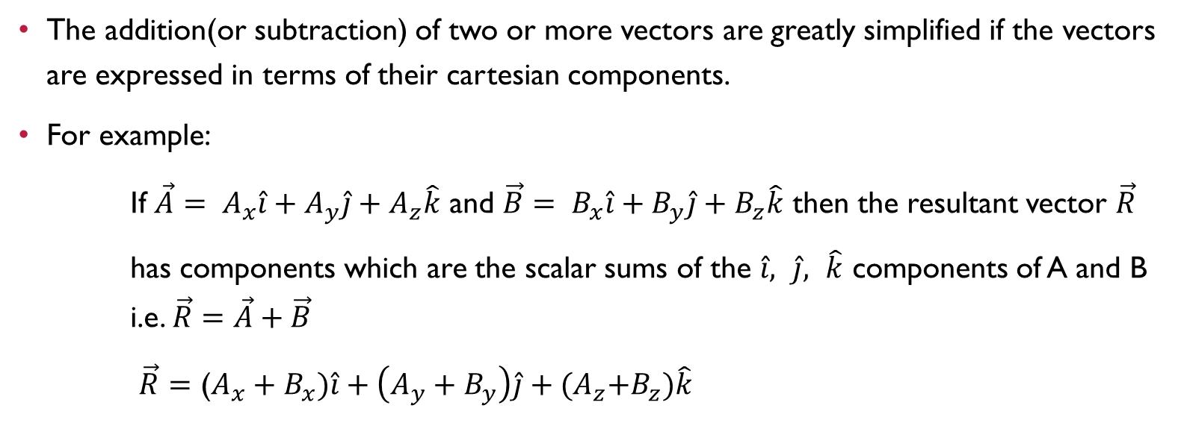
Addition of cartesian vectors
The addition(or subtraction) of two or more vectors are greatly simplified if the vectors are expressed in terms of their cartesian components.
For example:
If $\vec{A}= A_{x}\hat{i}+A_{y}\hat{j}+A_{z}\hat{k}$ and $\vec{B}= B_{x}\hat{i}+B_{y}\hat{j}+B_{z}\hat{k}$ then the resultant vector $\vec{R}$
has components which are the scalar sums of the $\hat{i}, \hat{j}, \hat{k}$ components of A and B i.e. $\vec{R}=\vec{A}+\vec{B}$
$\vec{R}=$ ($A_{x}+B_{x})\hat{i}+\left(A_{y}+B_{y}\right)\hat{j}+{(A}_{z}+B_{z})\hat{k}$

Slide 12
Coplanar Concurrent Forces
A force system is said to be Coplanar and Concurrent , if the lines of action of all the forces lie in one plane and intersect at a common point

Slide 13
Non-coplanar Concurrent Forces
A force system is said to be Non-coplanar and Concurrent , if the lines of action of all the forces lie different plane and intersect at a common point

Slide 14
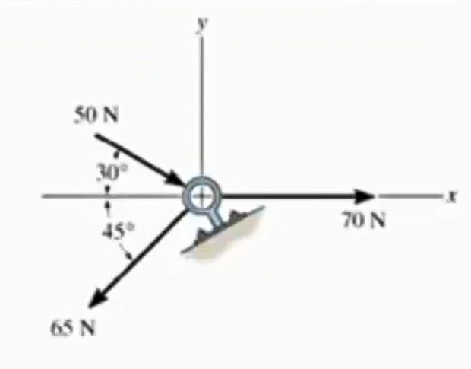
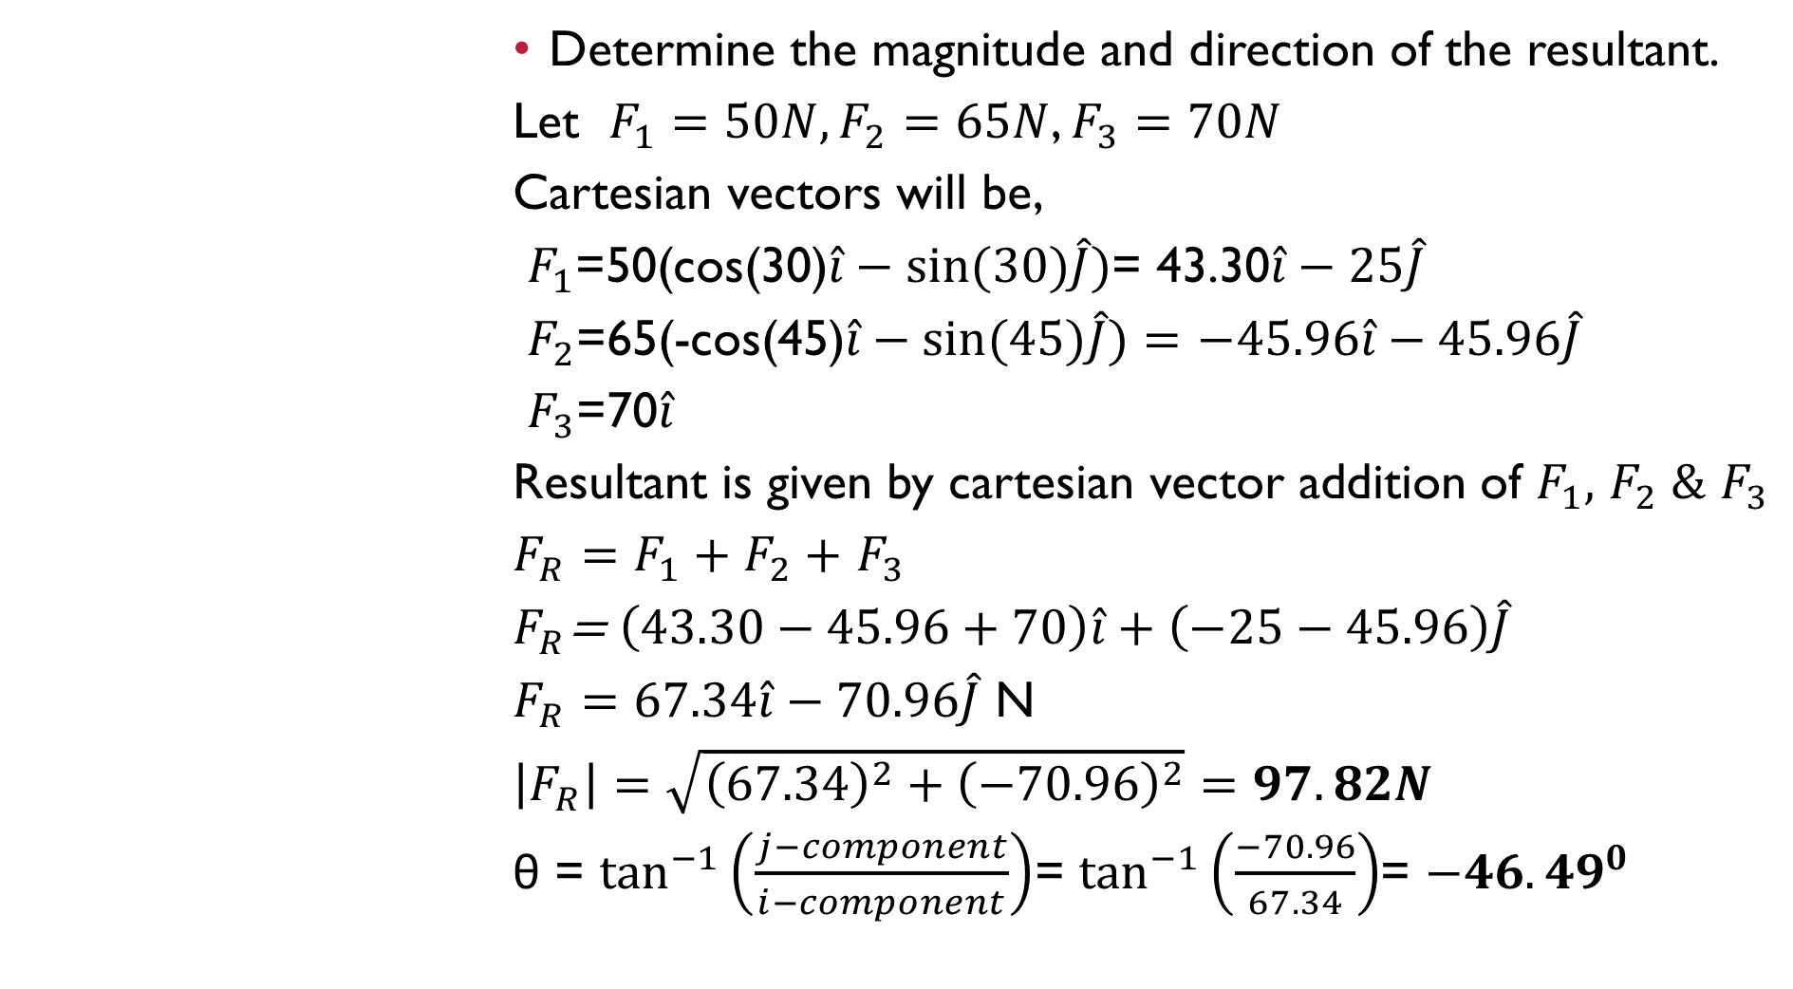
Determine the magnitude and direction of the resultant.
Let $F_{1}=50N,F_{2}=65N$, $F_{3}=70N$
Cartesian vectors will be,
$F_{1}$=50(cos(30)$\hat{i}−sin⁡(30)\hat{J})$= 43.30$\hat{i}−25\hat{J}$
$F_{2}$=65(-cos(45)$\hat{i}−sin⁡(45)\hat{J})=$ $−45.96\hat{i}−45.96\hat{J}$
$F_{3}$=70$\hat{i}$
Resultant is given by cartesian vector addition of $F_{1},$ $F_{2} \&$ $F_{3}$
$F_{R}=F_{1}+F_{2}+$ $F_{3}$
$F_{R}$= $\left(43.30−45.96+70\right)\hat{i}+\left(−25−45.96\right)\hat{J}$
$F_{R}=67.34\hat{i}−70.96\hat{J}$ N
$\left|F_{R}\right|=$ $\sqrt{{\left(67.34\right)}^{2}+{\left(−70.96\right)}^{2}}=97.82N$
θ = $\tan^{−1}\left(\frac{j−component}{i−component}\right)$= $\tan^{−1}\left(\frac{−70.96}{67.34}\right)$= ${−46.49}^{0}$

Slide 15
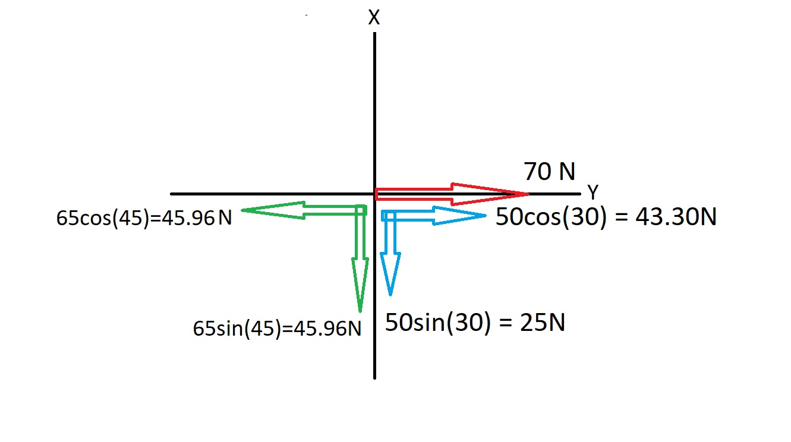
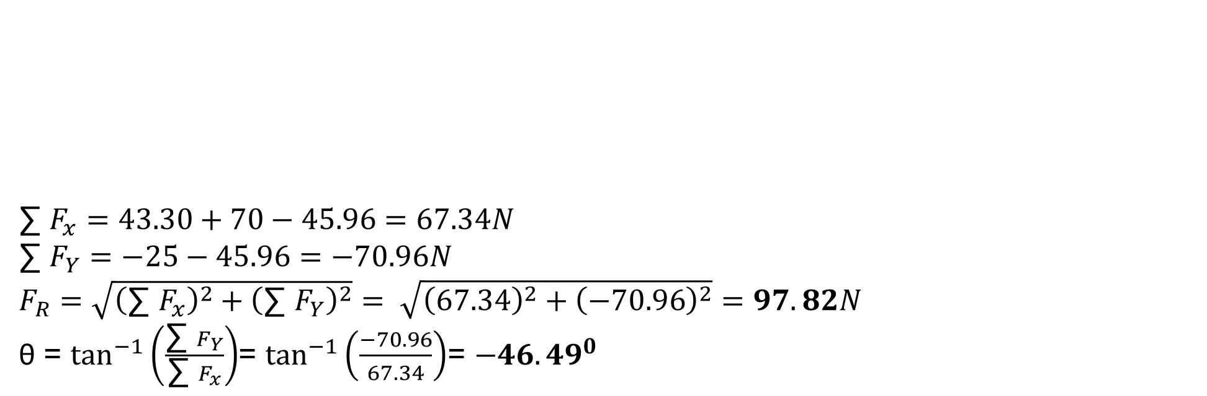
∑ $F_{x}=43.30+70−45.96=67.34N$
∑ $F_{Y}=−25−45.96=−70.96N$
$F_{R}=$ $\sqrt{{\left(\text{∑ }F_{x}\right)}^{2}+{\left(\text{∑ }F_{Y}\right)}^{2}}= \sqrt{{\left(\text{67.34}\right)}^{2}+{\left(\text{−70.96}\right)}^{2}}=97.82N$
θ = $\tan^{−1}\left(\frac{\text{∑ }F_{Y}}{\text{∑ }F_{x}}\right)$= $\tan^{−1}\left(\frac{−70.96}{67.34}\right)$= ${−46.49}^{0}$

Slide 16
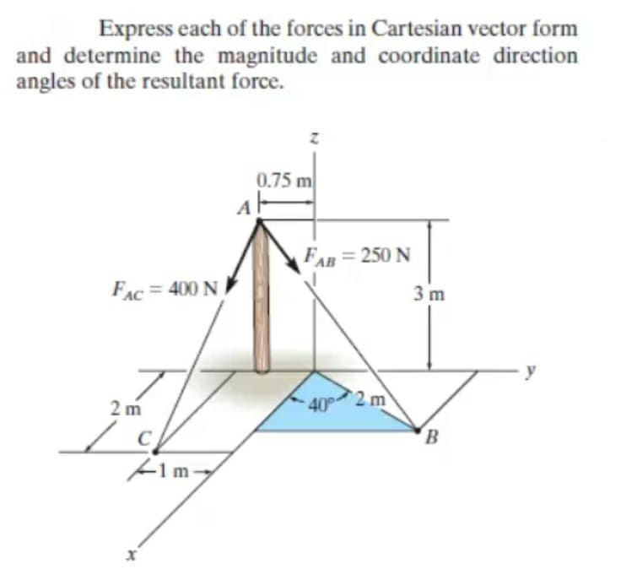
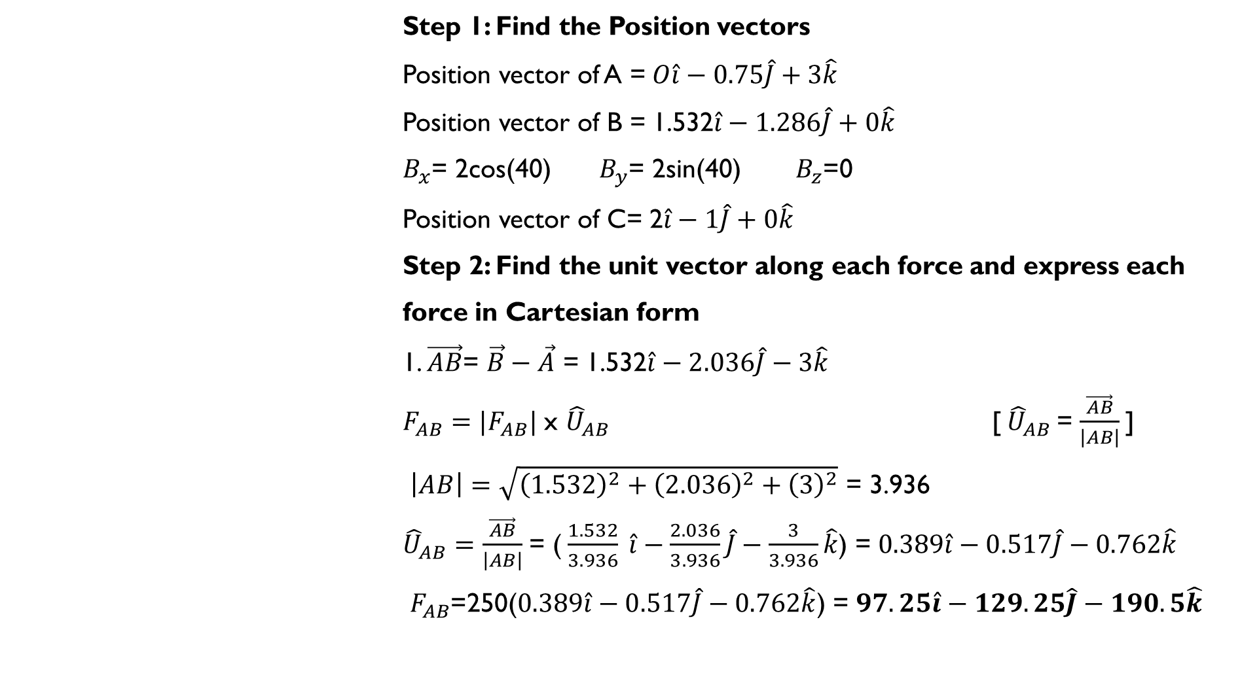
Step 1: Find the Position vectors
Position vector of A =$O\hat{i}−0.75\hat{J}+3\hat{k}$
Position vector of B = 1.532$\hat{i}−1.286\hat{J}+0\hat{k}$
$B_{x}$= 2cos(40) $B_{y}$= 2sin(40) $B_{z}$=0
Position vector of C= 2$\hat{i}−1\hat{J}+0\hat{k}$
Step 2: Find the unit vector along each force and express each
force in Cartesian form
1. $\vec{AB}$= $\vec{B}−\vec{A}$ = 1.532$\hat{i}−2.036\hat{J}−3\hat{k}$
$F_{AB}=|F_{AB}|$ x ${\hat{U}}_{AB}$ [${\hat{U}}_{AB}$= $\frac{\vec{AB}}{\left|AB\right|}$]
$\left|AB\right|=\sqrt{{\left(1.532\right)}^{2}+{\left(2.036\right)}^{2}+{\left(3\right)}^{2}}$ = 3.936
${\hat{U}}_{AB}=\frac{\vec{AB}}{\left|AB\right|}$ = ($\frac{1.532}{3.936} \hat{i}−\frac{2.036}{3.936}\hat{J}−\frac{3}{3.936}\hat{k}$) = $0.389\hat{i}−0.517\hat{J}−0.762\hat{k}$
$F_{AB}$=250($0.389\hat{i}−0.517\hat{J}−0.762\hat{k}$) = $97.25\hat{i}−129.25\hat{J}−190.5\hat{k}$

Slide 17
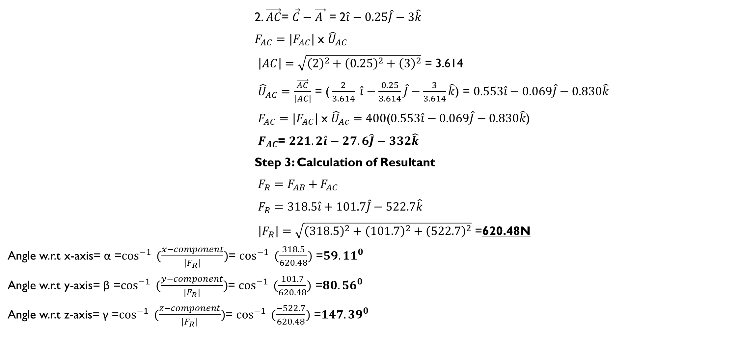
2. $\vec{AC}$= $\vec{C}−\vec{A }$ = 2$\hat{i}−0.25\hat{J}−3\hat{k}$
$F_{AC}=|F_{AC}|$ x ${\hat{U}}_{AC}$
$\left|AC\right|=\sqrt{{\left(2\right)}^{2}+{\left(0.25\right)}^{2}+{\left(3\right)}^{2}}$ = 3.614
${\hat{U}}_{AC}=\frac{\vec{AC}}{\left|AC\right|}$ = ($\frac{2}{3.614} \hat{i}−\frac{0.25}{3.614}\hat{J}−\frac{3}{3.614}\hat{k}$) = $0.553\hat{i}−0.069\hat{J}−0.830\hat{k}$
$F_{AC}=|F_{AC}|$ x ${\hat{U}}_{Ac}=400$($0.553\hat{i}−0.069\hat{J}−0.830\hat{k}$)
$F_{AC}$= $221.2\hat{i}−27.6\hat{J}−332\hat{k}$
Step 3: Calculation of Resultant
$F_{R}=F_{AB}+F_{AC}$
$F_{R}=$ $318.5\hat{i}+101.7\hat{J}−522.7\hat{k}$
$\left|F_{R}\right|=$ $\sqrt{{\left(318.5\right)}^{2}+{\left(101.7\right)}^{2}+{\left(522.7\right)}^{2}}$ =620.48N
Angle w.r.t x-axis= α =$\cos^{−1}{ (\frac{x−component}{\left|F_{R}\right|})}$= $\cos^{−1}{ (\frac{318.5}{620.48})}$ =${59.11}^{0}$
Angle w.r.t y-axis= β =$\cos^{−1}{ (\frac{y−component}{\left|F_{R}\right|})}$= $\cos^{−1}{ (\frac{101.7}{620.48})}$ =${80.56}^{0}$
Angle w.r.t z-axis= γ =$\cos^{−1}{ (\frac{z−component}{\left|F_{R}\right|})}$= $\cos^{−1}{ (\frac{−522.7}{620.48})}$ =${147.39}^{0}$

Slide 18

Thank You

